Slide 1
ETHERNET NEDİR?
Network ile ilgili bir terim. Ethernet 1980 yılında ortaya çıkıyor ve 1983 yılında IEEE 802.3 olarak standardize ediliyor.
Local area network (LAN) için physical ve data link layer seviyesinde protokol tanımlarını içeriyor. Wireless içinse IEEE 802.11 (1999) (Wi-Fi) kullanılıyor.
OSI model:
1- Physical layer
2- Data link layer
3- Network layer
4- Transport layer
5- Session layer
6- Presentation layer
7- Application layer
VIDEO
AREA
3,24 cm
4,32 cm

Slide 2
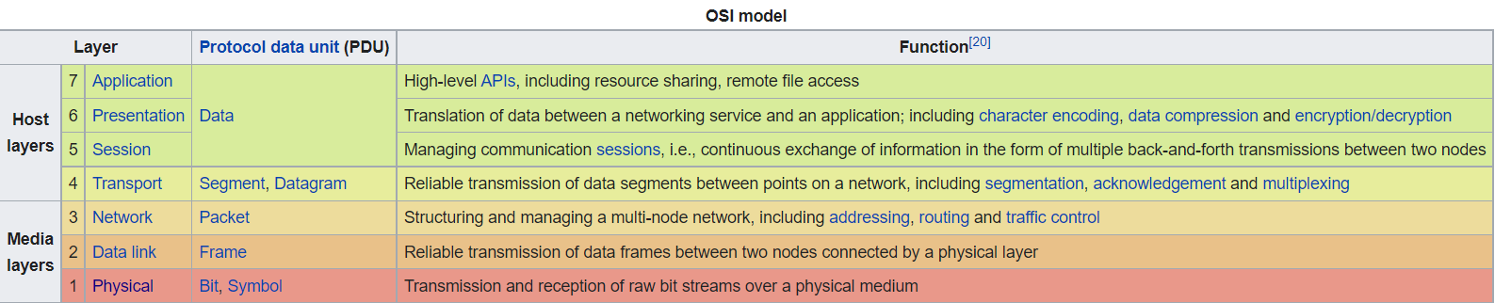
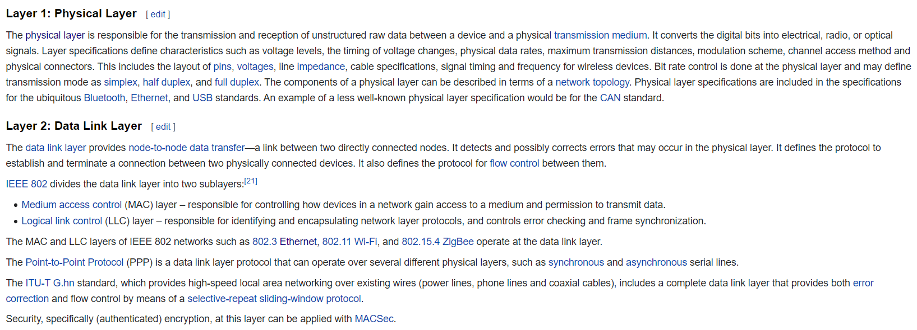
OSI (Open Systems Interconnection) MODEL 7-LAYERS
VIDEO
AREA
3,24 cm
4,32 cm

Slide 3
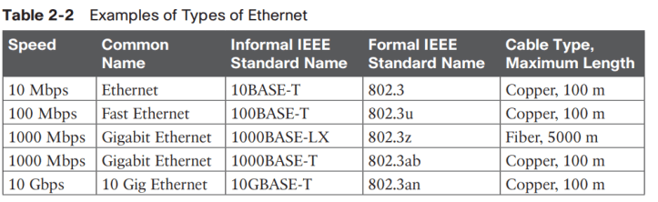
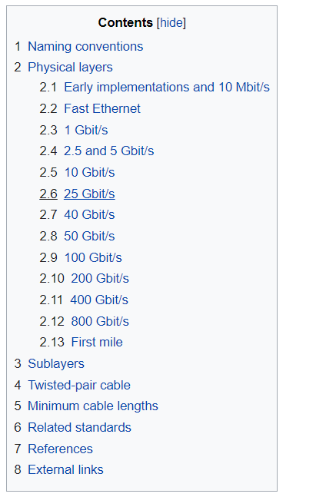
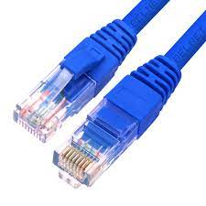
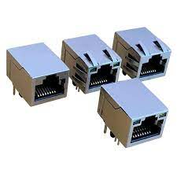
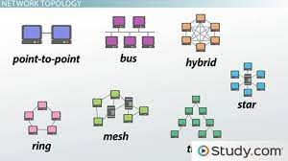
802.3 PHYSICAL LAYER
Old
New – Need hub device
VIDEO
AREA
3,24 cm
4,32 cm

Slide 4
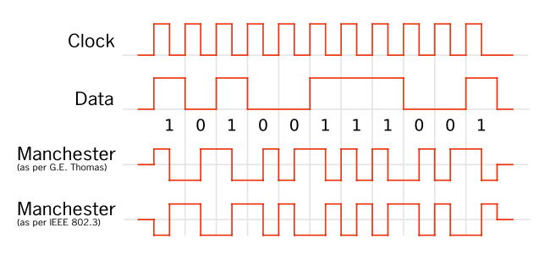
802.3 PHYSICAL LAYER
Data encoding type: Manchester encoding
VIDEO
AREA
3,24 cm
4,32 cm

Slide 5
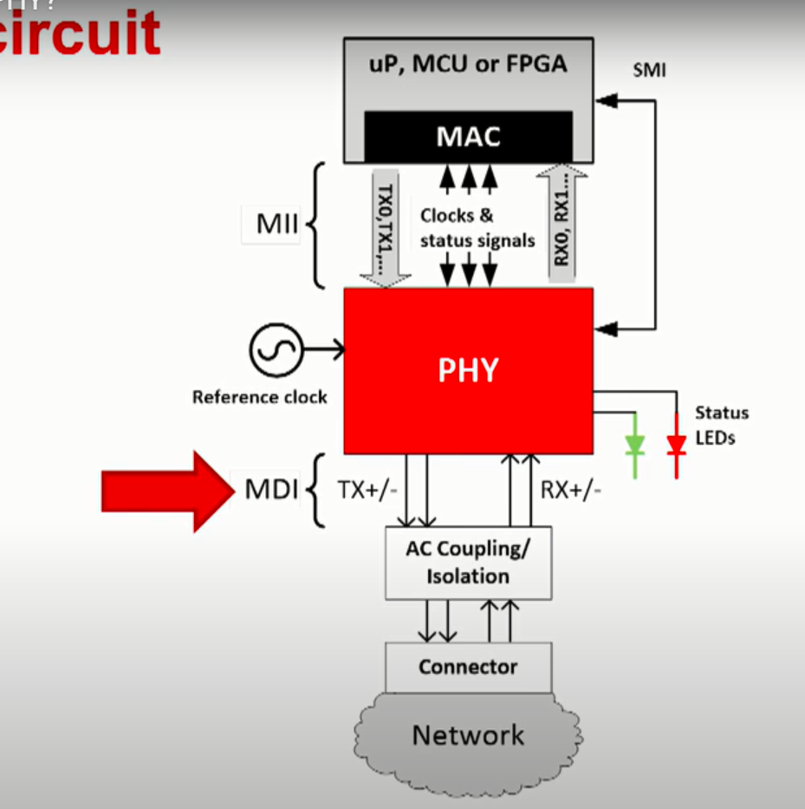
VIDEO
AREA
3,24 cm
4,32 cm

Slide 6
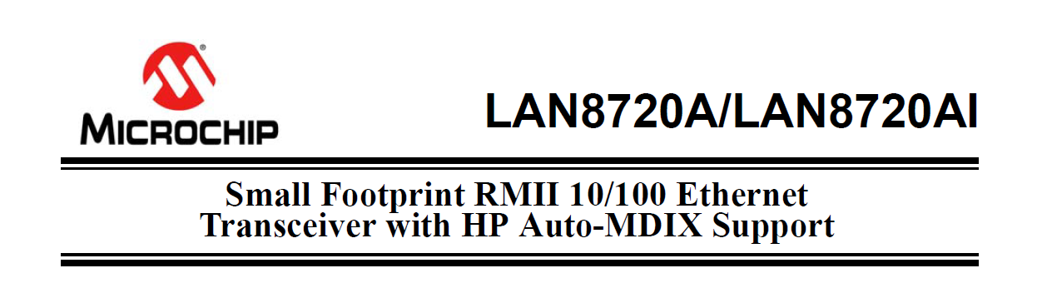
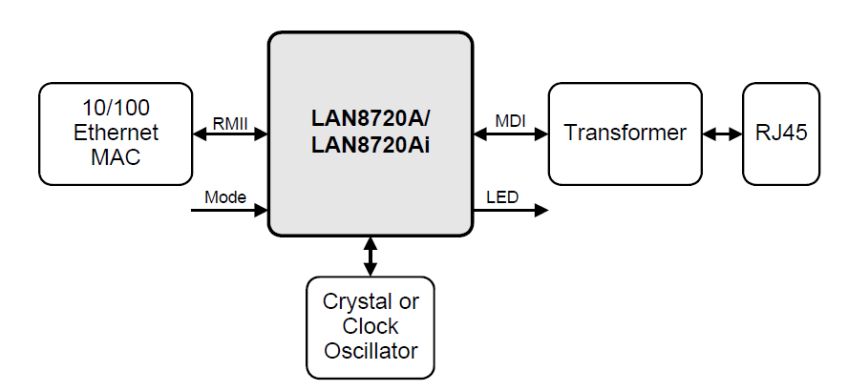
VIDEO
AREA
3,24 cm
4,32 cm

Slide 7
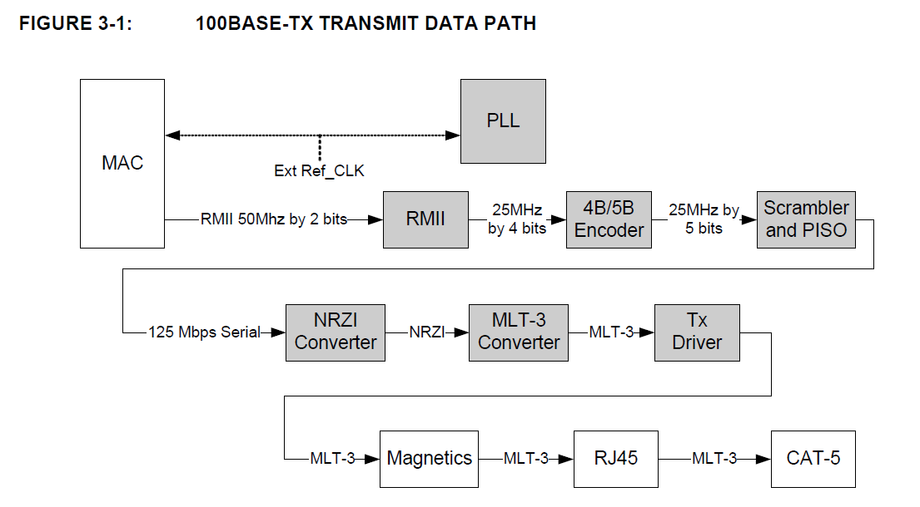
VIDEO
AREA
3,24 cm
4,32 cm

Slide 8
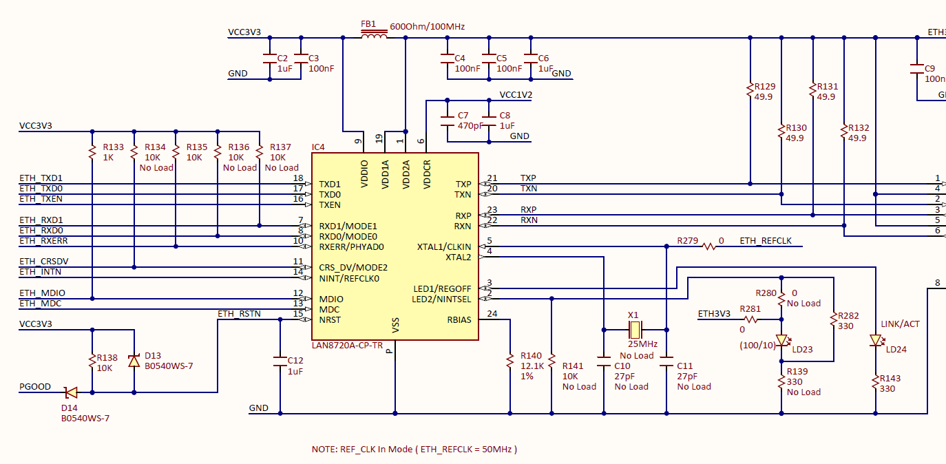
VIDEO
AREA
3,24 cm
4,32 cm

Slide 9
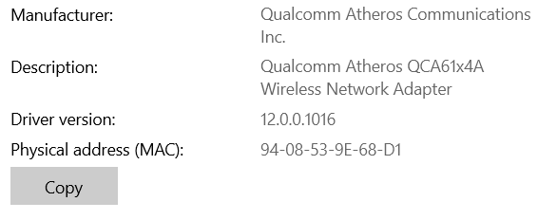
802.3 DATA LINK LAYER
MAC (MEDIA/MEDIUM ACCESS CONTROLLER)
Ethernet stations communicate by sending each other data packets: blocks of data individually sent and delivered. As with other IEEE 802 LANs, adapters come programmed with globally unique 48-bit MAC address so that each Ethernet station has a unique address.^{[b]} The MAC addresses are used to specify both the destination and the source of each data packet. Ethernet establishes link-level connections, which can be defined using both the destination and source addresses. On reception of a transmission, the receiver uses the destination address to determine whether the transmission is relevant to the station or should be ignored. A network interface normally does not accept packets addressed to other Ethernet stations
NIC – Network Interface Controller
36-20-A4-3F-F1
VIDEO
AREA
3,24 cm
4,32 cm

Slide 10
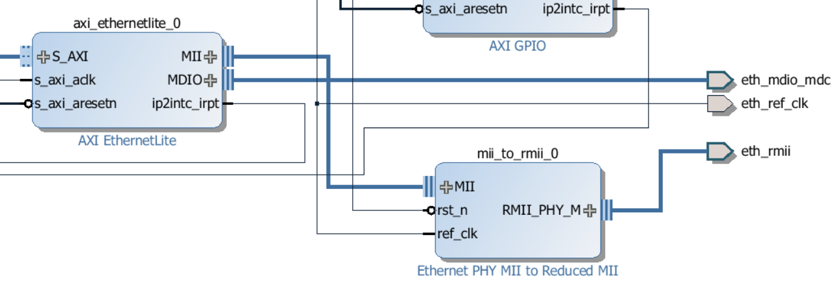
802.3 DATA LINK LAYER
MAC (MEDIA/MEDIUM ACCESS CONTROLLER)
VIDEO
AREA
3,24 cm
4,32 cm

Slide 11
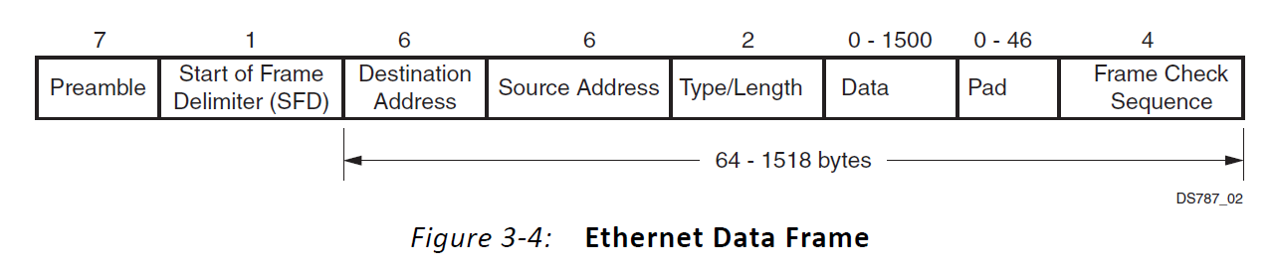
802.3 DATA LINK LAYER
MAC (MEDIA/MEDIUM ACCESS CONTROLLER)
VIDEO
AREA
3,24 cm
4,32 cm

Slide 12
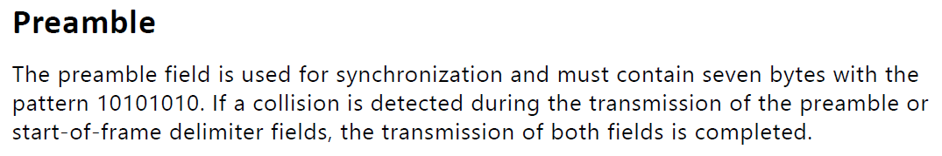
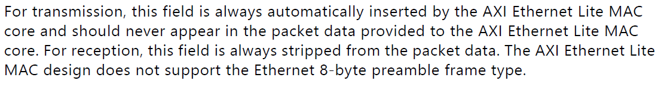
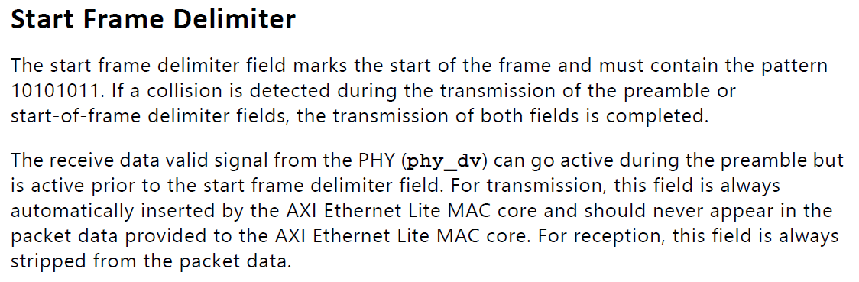
VIDEO
AREA
3,24 cm
4,32 cm

Slide 13
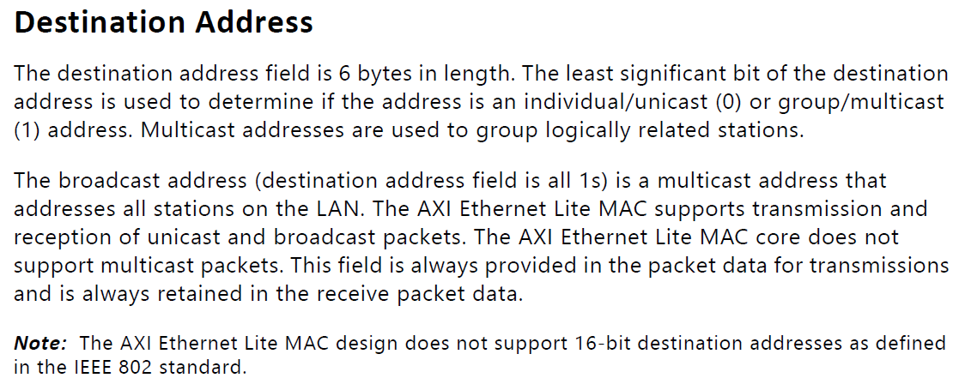
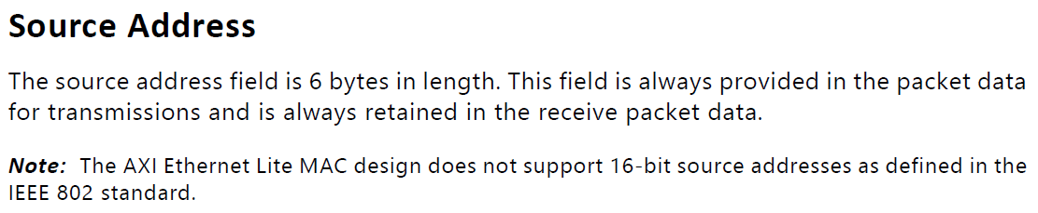
VIDEO
AREA
3,24 cm
4,32 cm

Slide 14
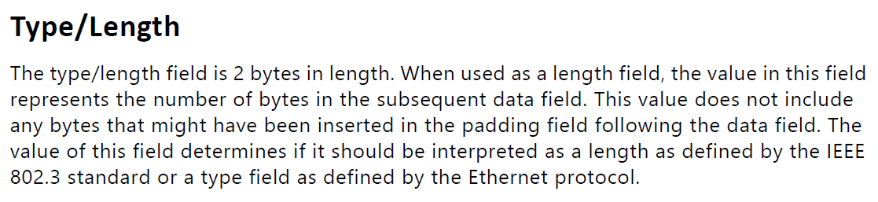
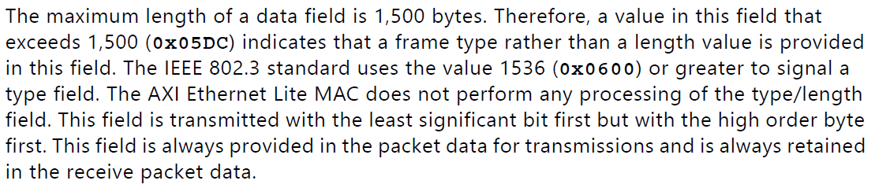
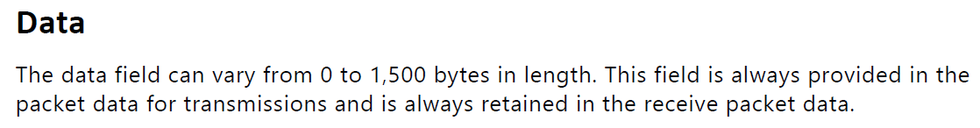
VIDEO
AREA
3,24 cm
4,32 cm

Slide 15
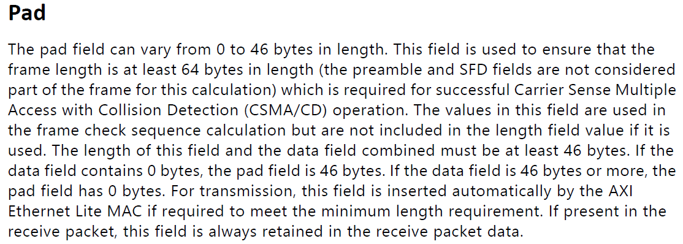
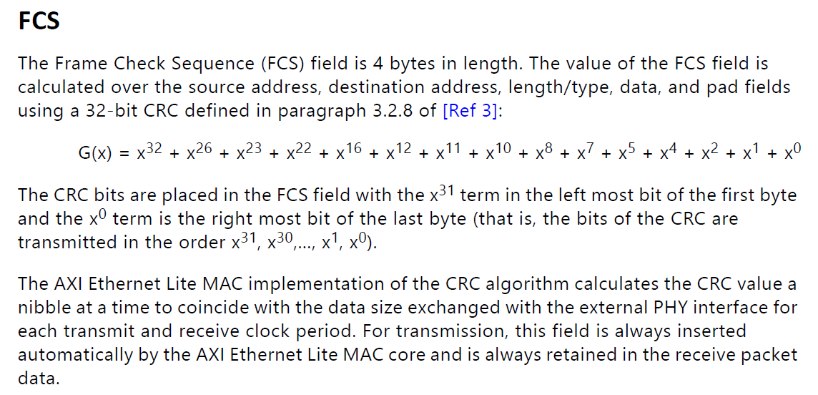
VIDEO
AREA
3,24 cm
4,32 cm

Slide 16
ETHERNET PROTOCOL
=
802.3 PHYSICAL LAYER
+
802.3 DATA LINK LAYER
Bir sonraki ders:
NETWORK & TRANSPORT LAYER: lwIP Open Source TCP/IP Stack
NEXYS4 DDR Kartında bilgisayar ile Ethernet üzerinden “echo server” uygulaması
VIDEO
AREA
3,24 cm
4,32 cm

